Slide 1
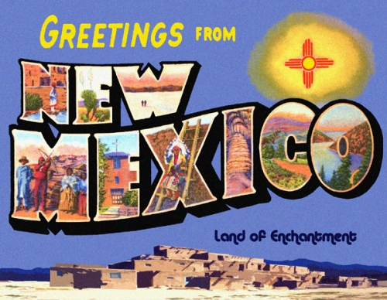
New Mexico Economy, Education, and Outlook
By Paul Gessing
Rio Grande Foundation

Slide 2

Rio Grande Foundation
Non-partisan;
Policy research on New Mexico’s economy;
Free market, limited government perspective.

Slide 3
Three Steps to Improve New Mexico
Tax Reform;
Education choice;
Restore balance in emergencies.

Slide 4
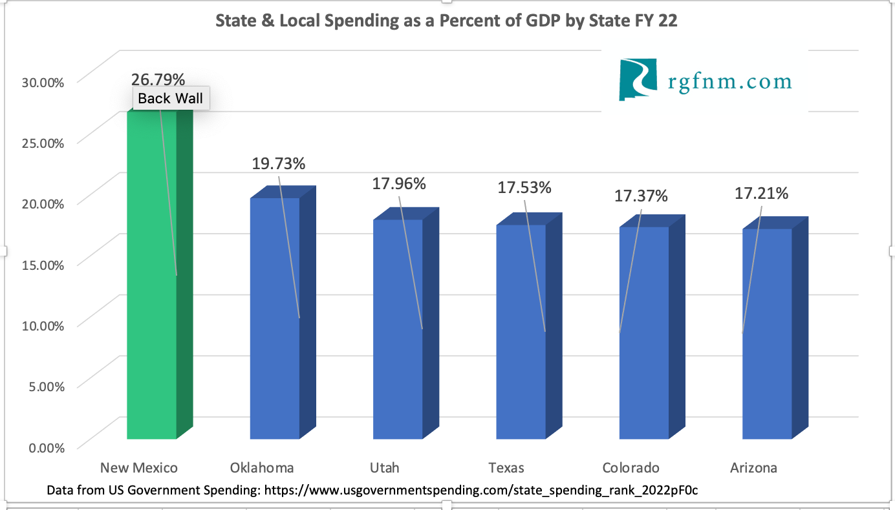
NM Government is Big

Slide 5
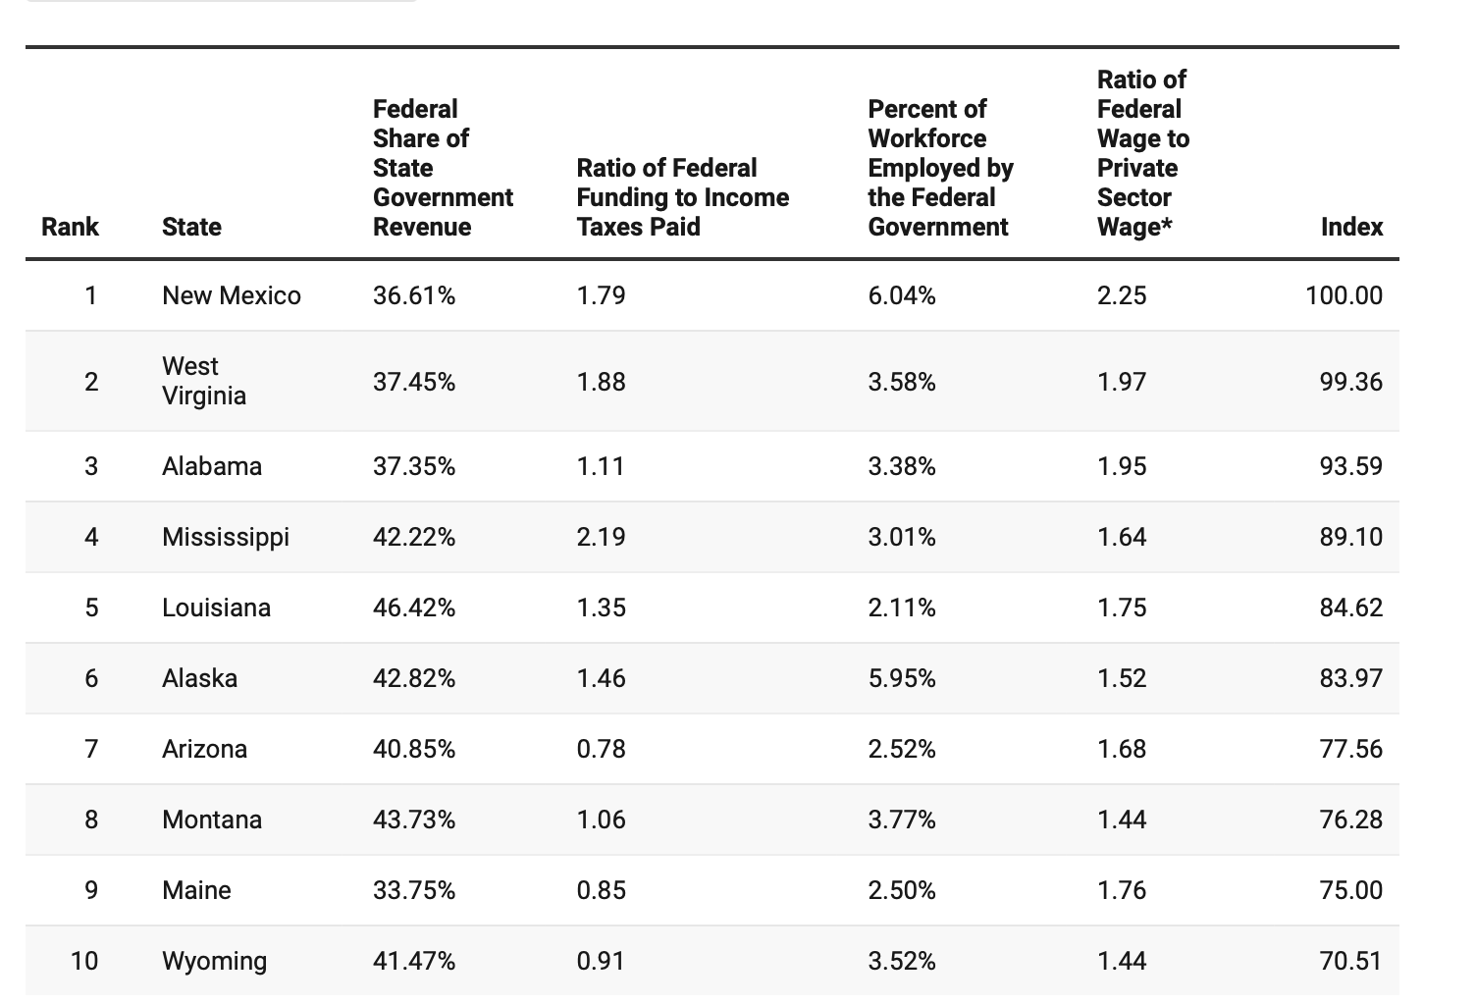
It’s also Federally-dependent
https://smartasset.com/taxes/states-most-dependent-on-the-federal-government-2021-edition

Slide 6
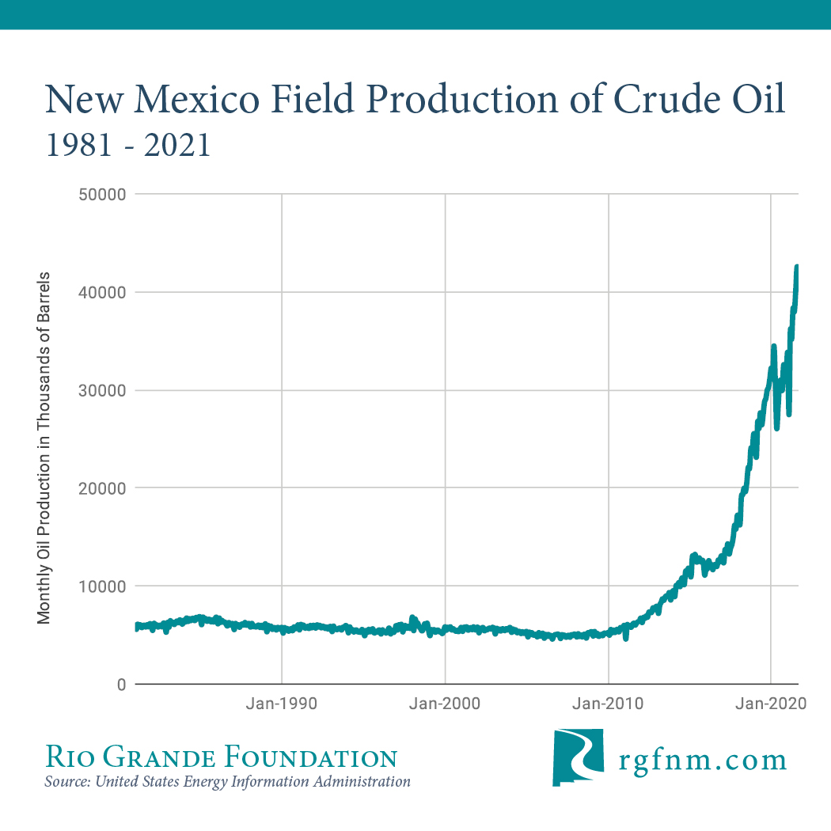
And oil-driven

Slide 7
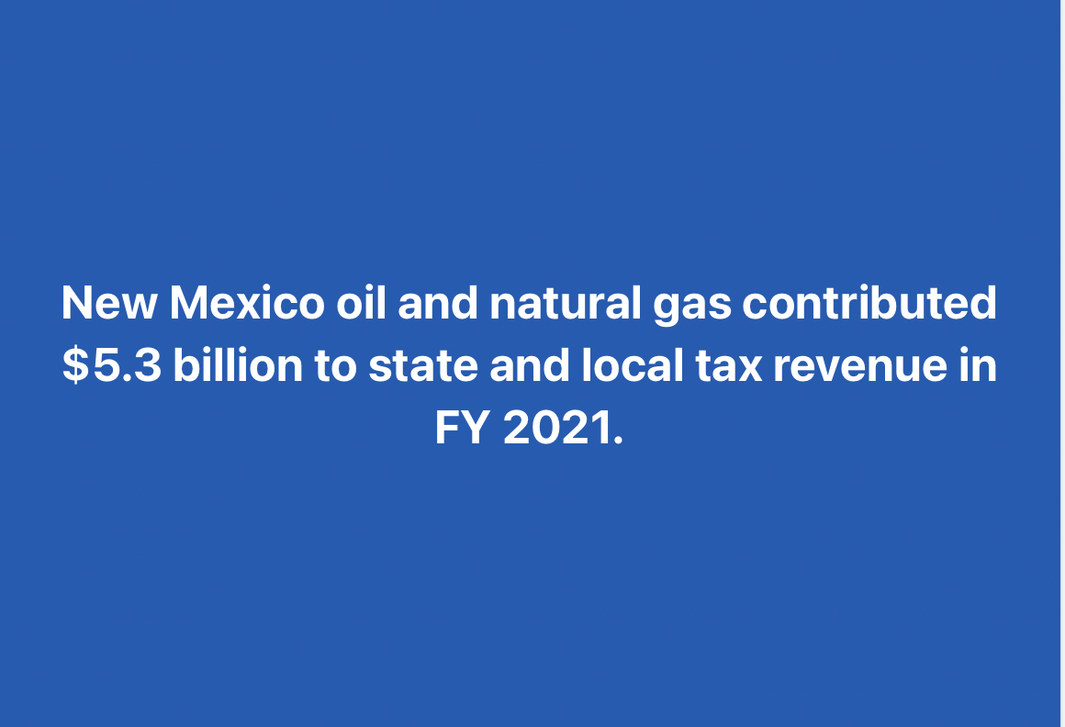

Slide 8
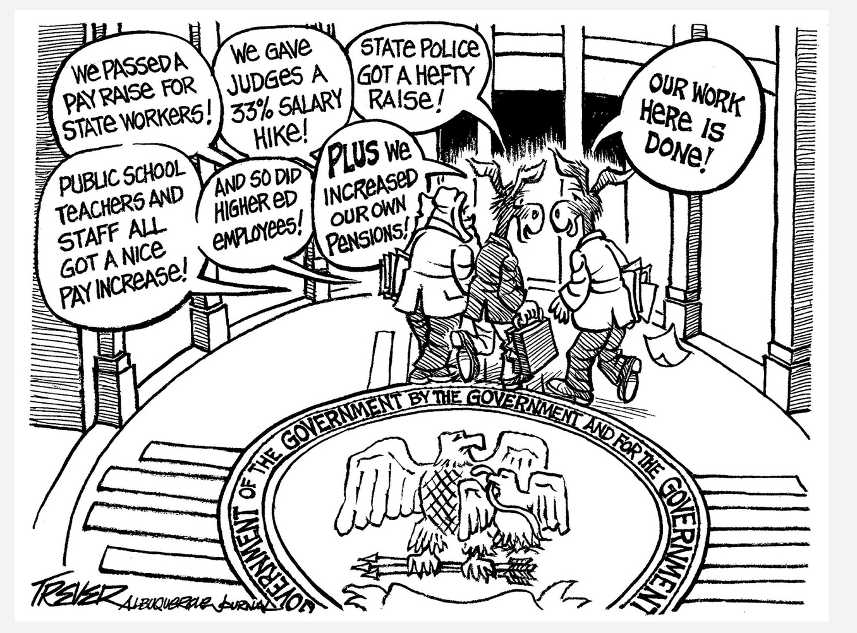

Slide 9
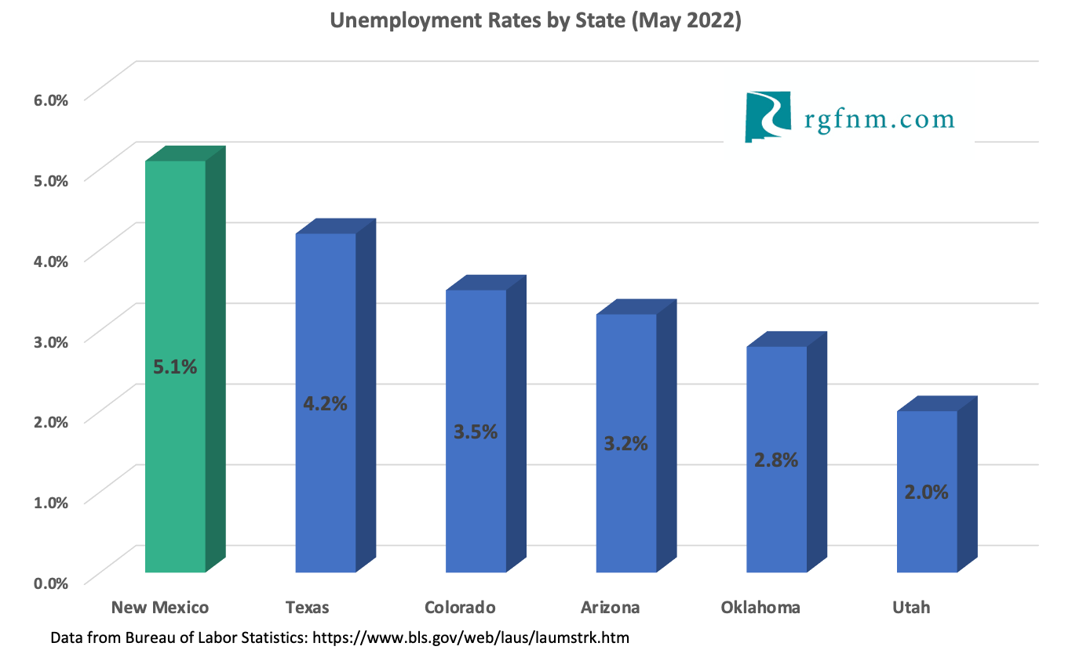
Yet, there are fundamental issues

Slide 10
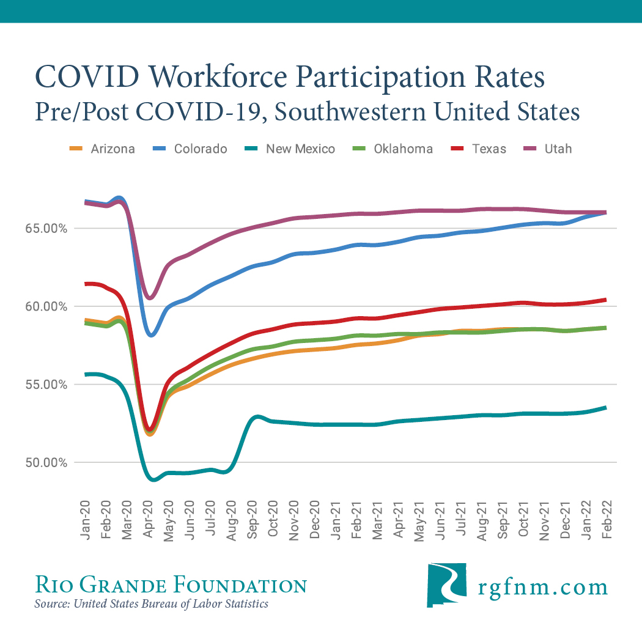

Slide 11
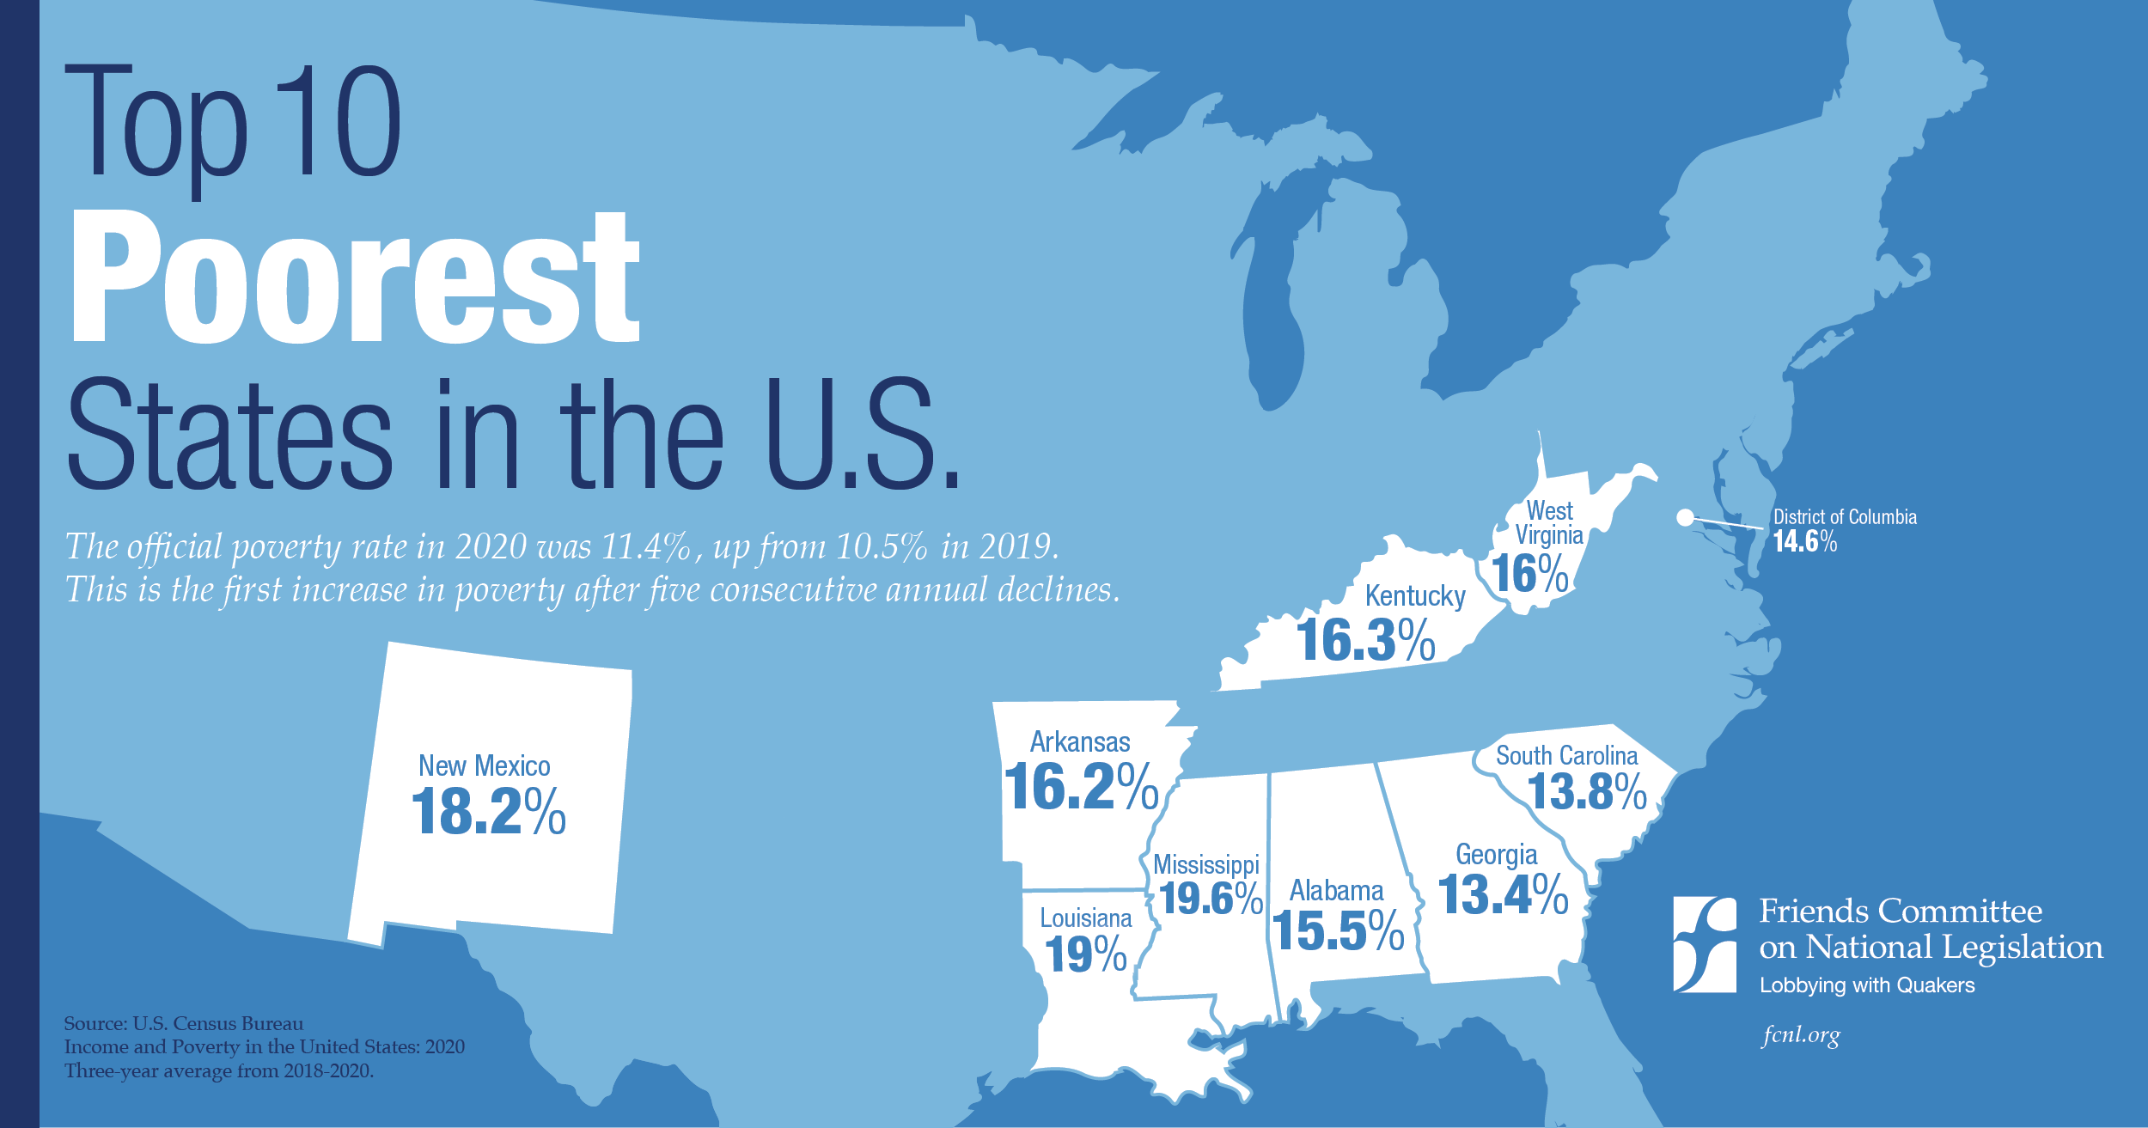

Slide 12
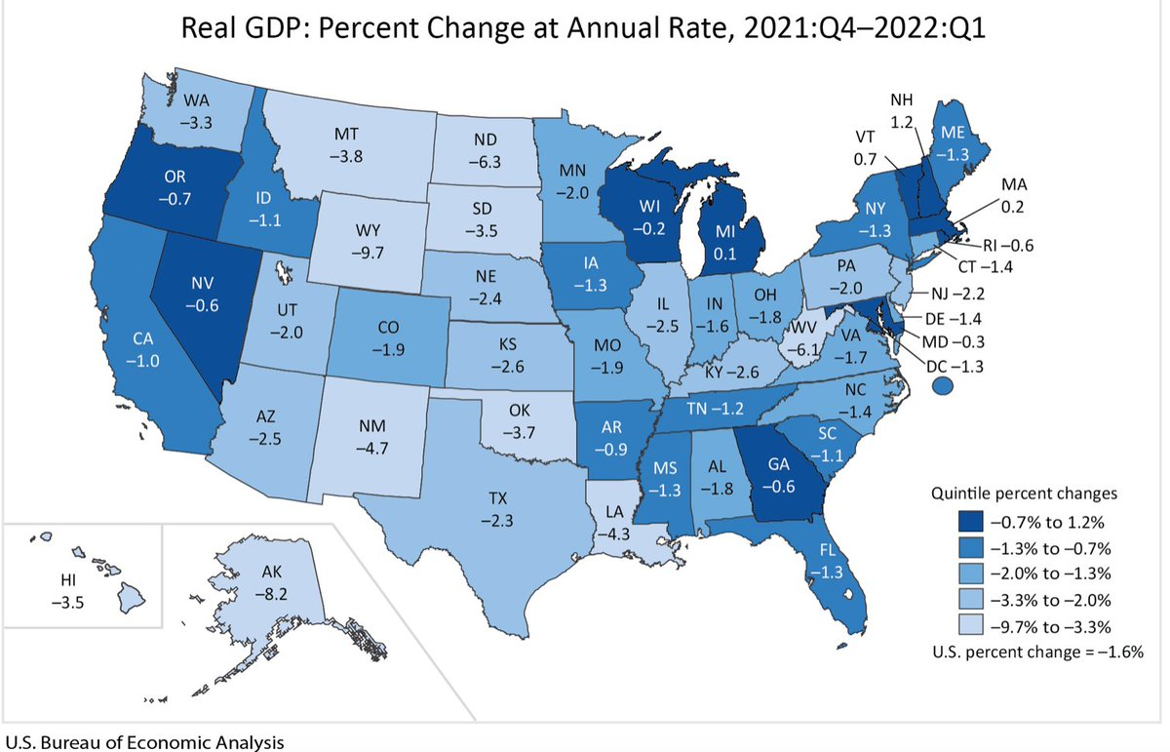

Slide 13
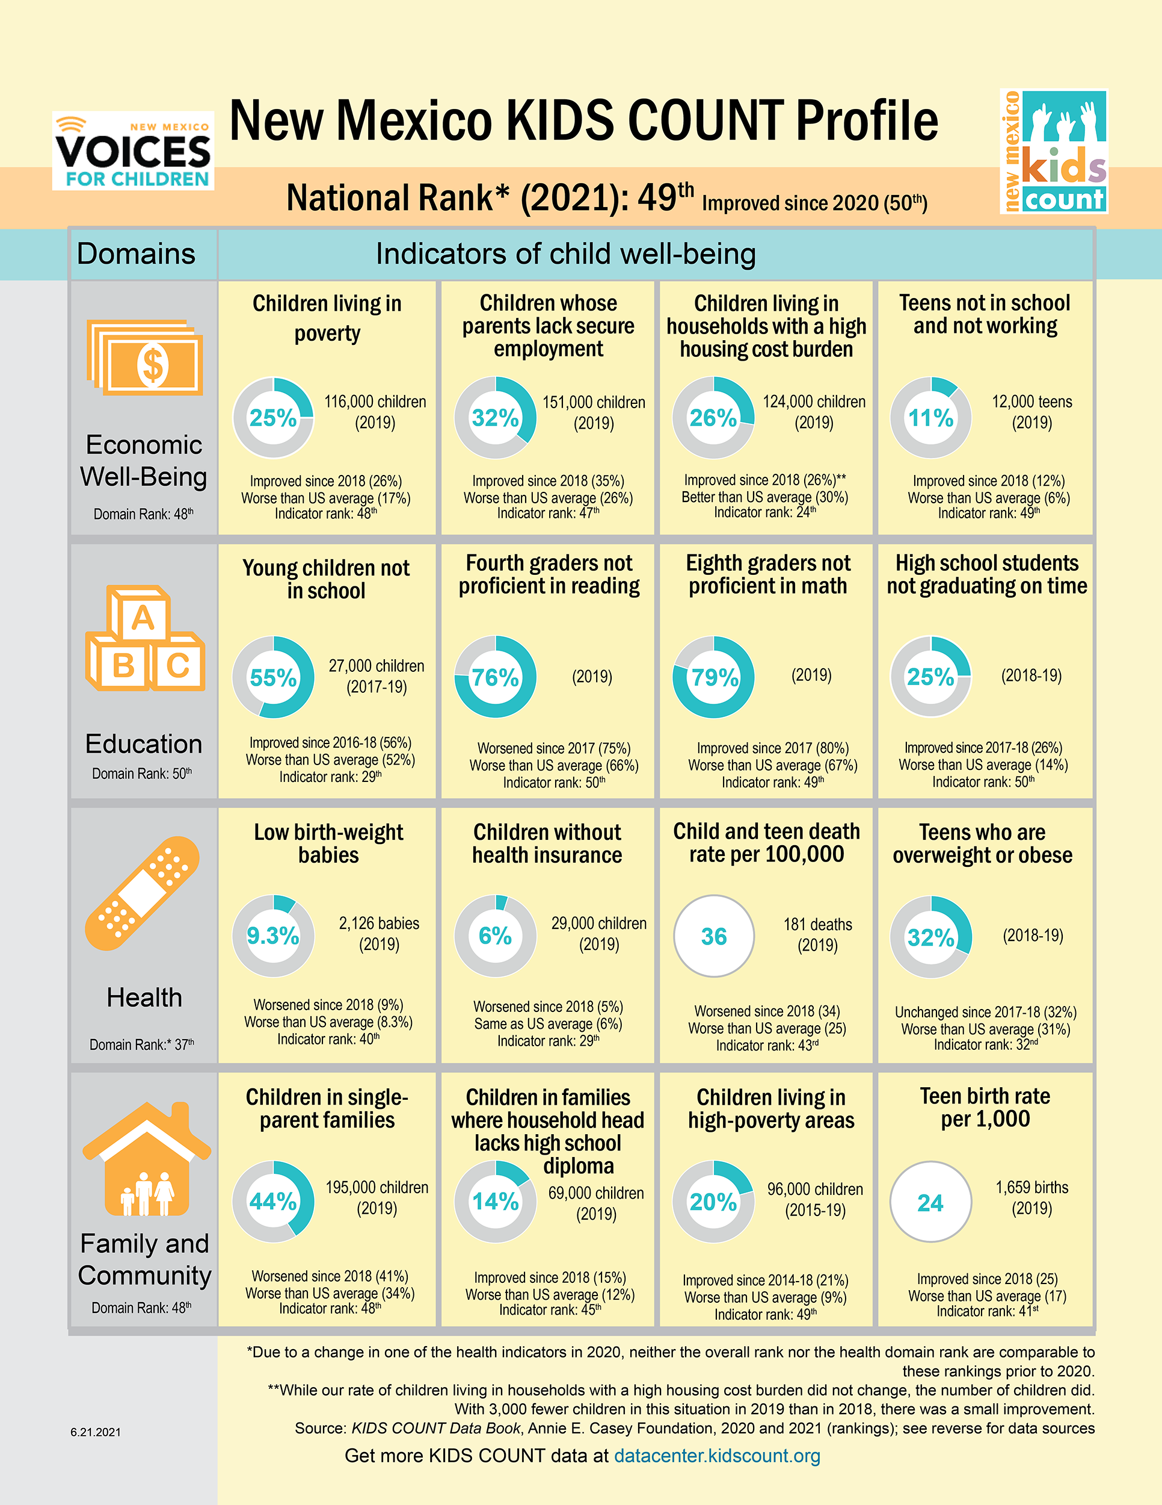
“Dogs” that didn’t bark

Slide 14
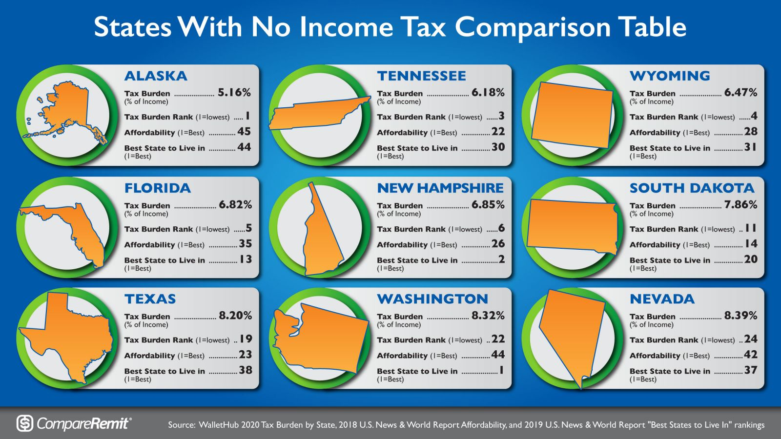

Slide 15
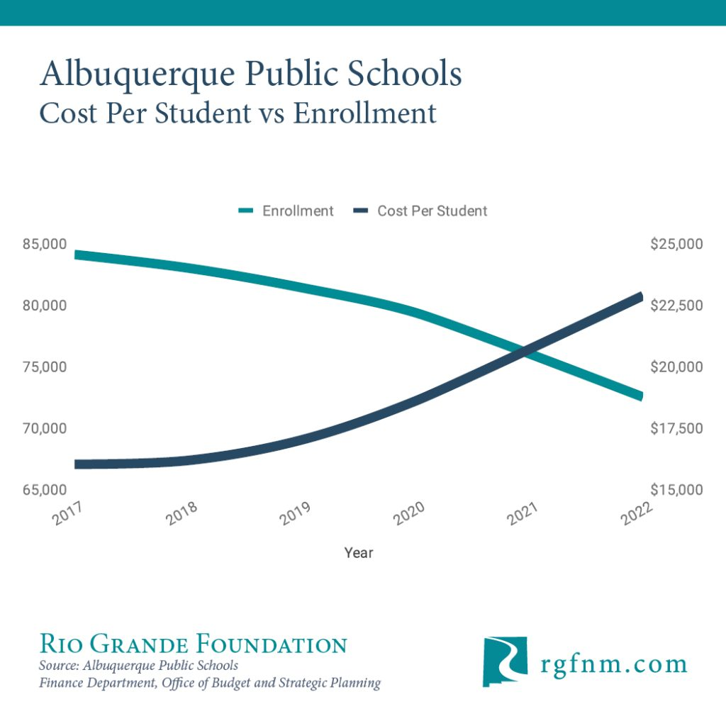

Slide 16
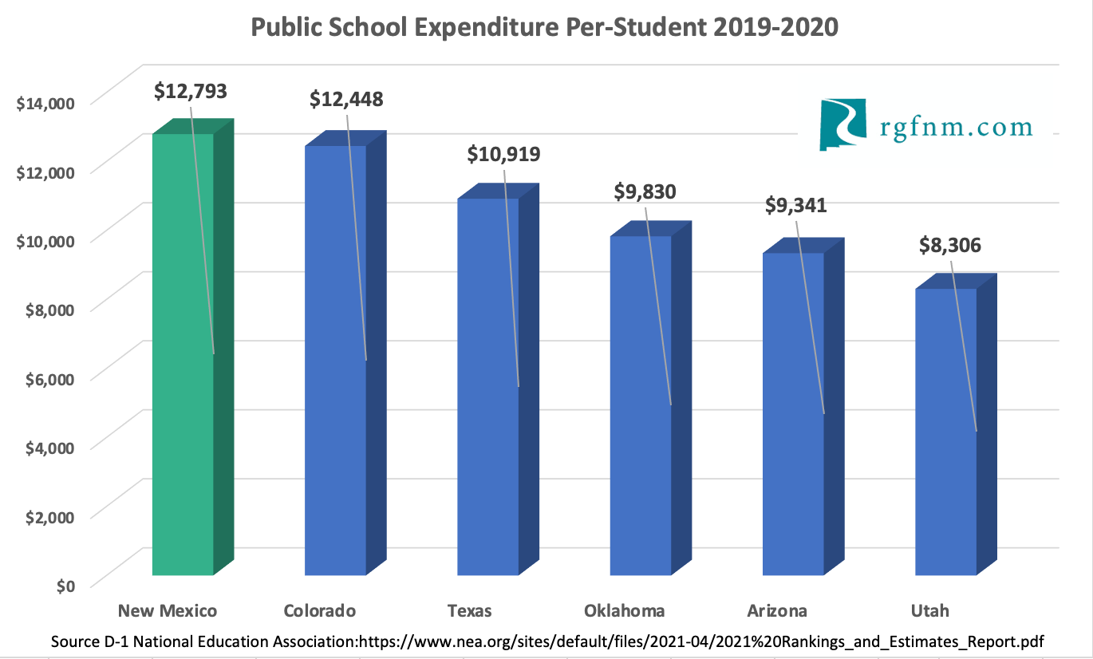

Slide 17
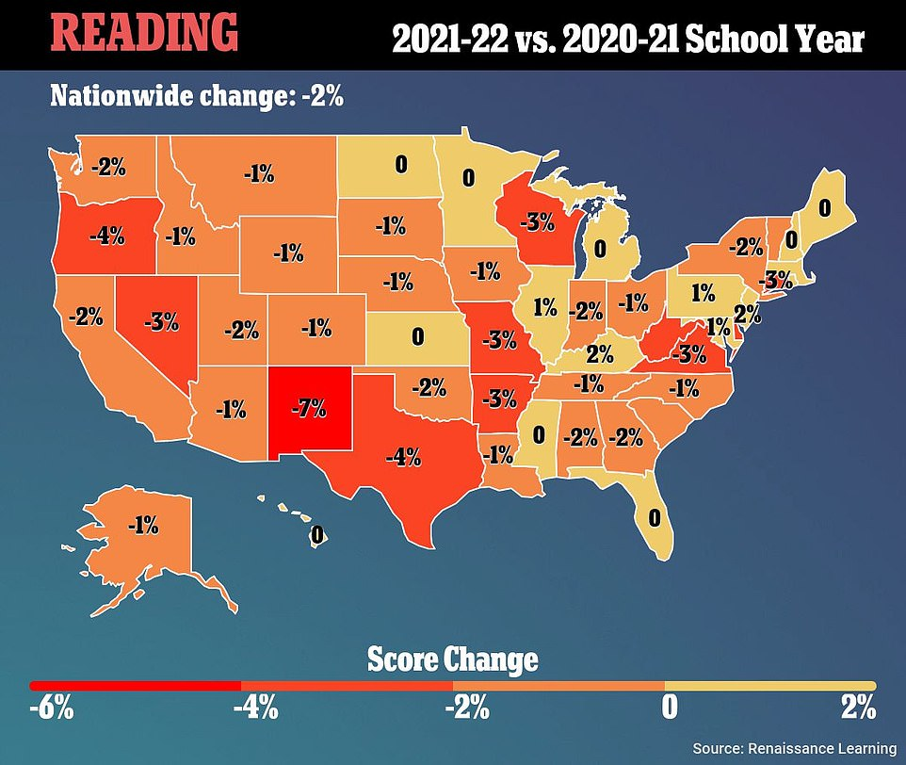
Source: Renaissance Learning Inc.

Slide 18
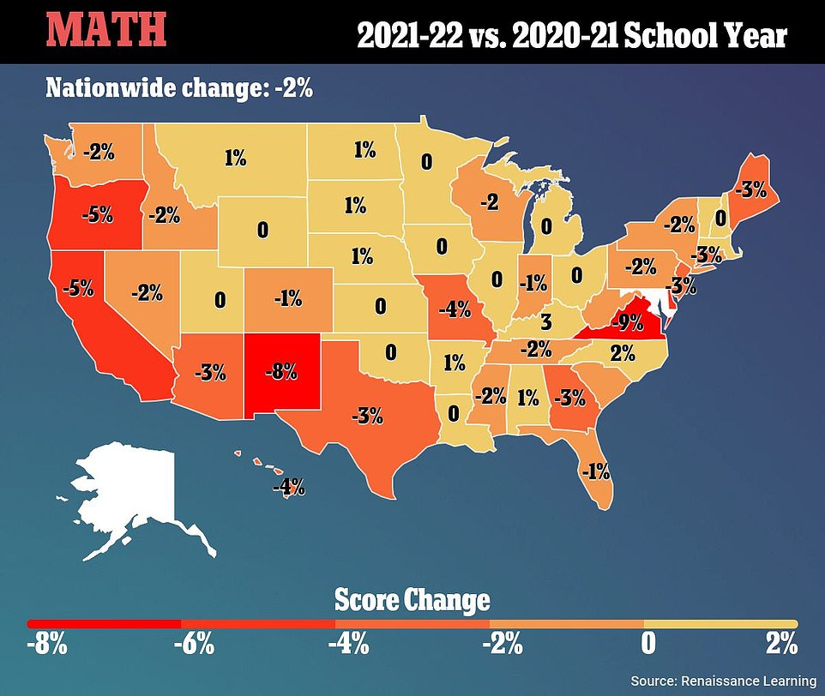

Slide 19
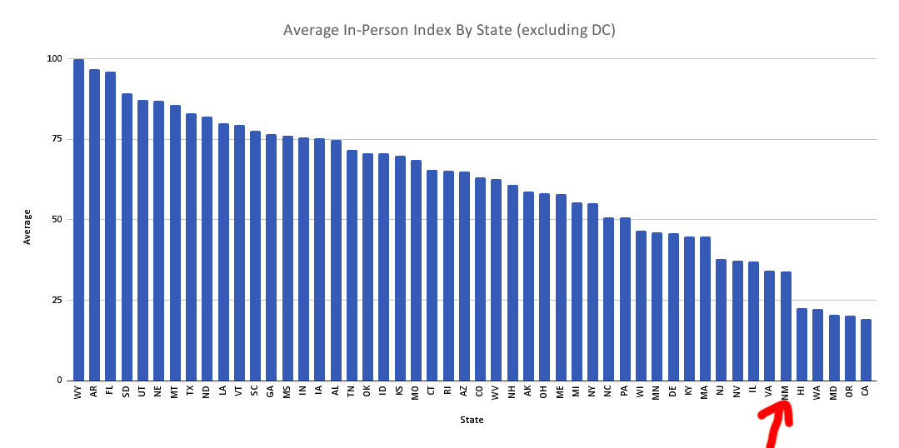
McKinsey: poor and minority kids will be hit hardest by loss of classroom time with the “AVERAGE K–12 student in the United States losing $61,000 to $82,000 in lifetime earnings (in constant 2020 dollars), or the equivalent of a year of full-time work, solely as a result of COVID-19–related learning losses.”

Slide 20
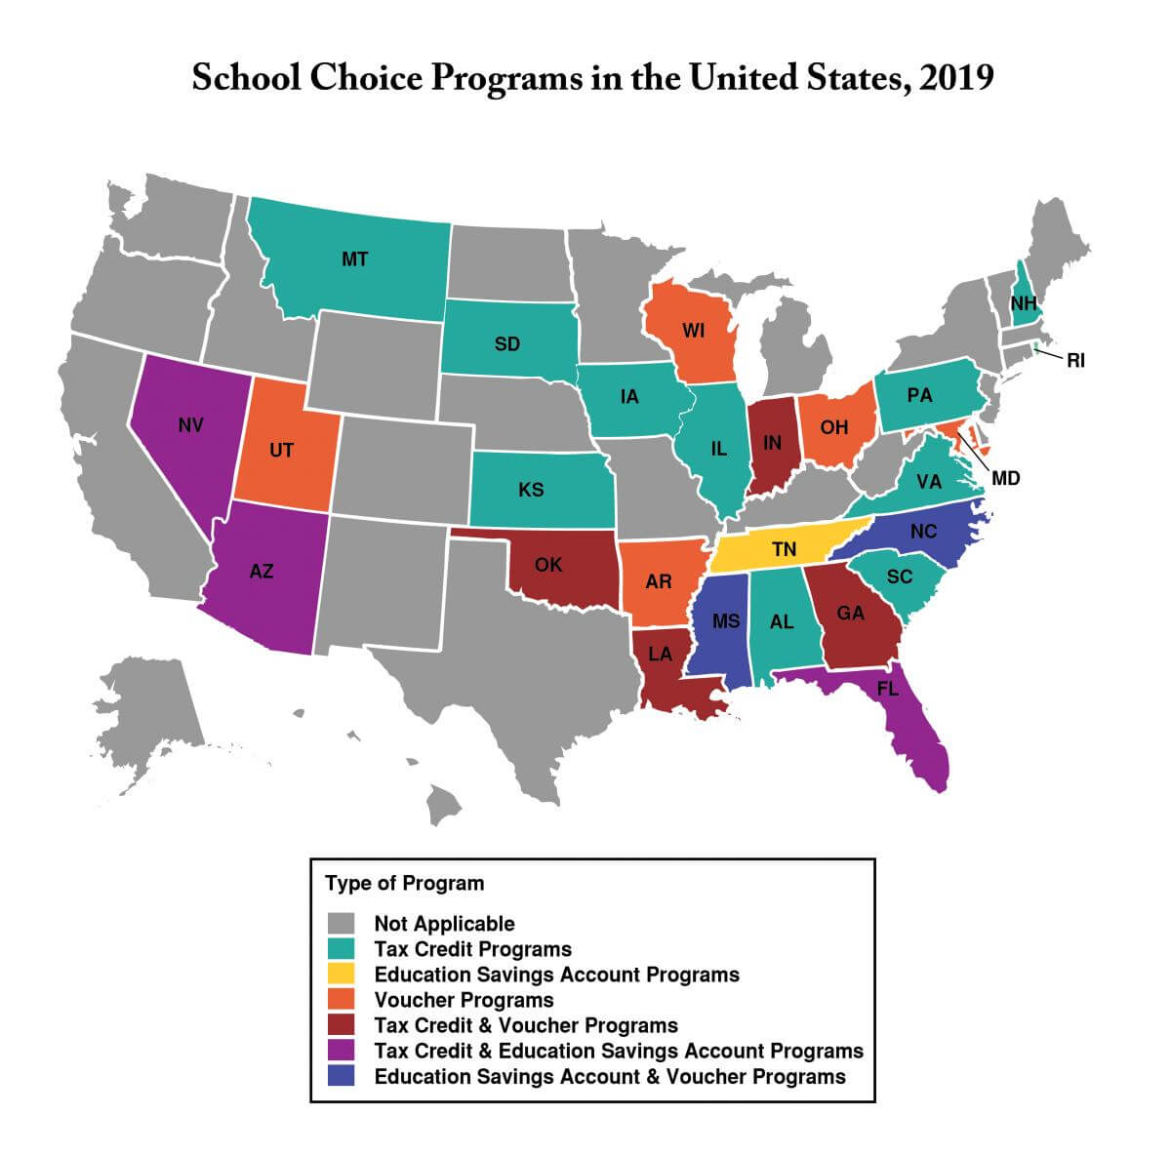
Before 2020 many states had private school choice

Slide 21
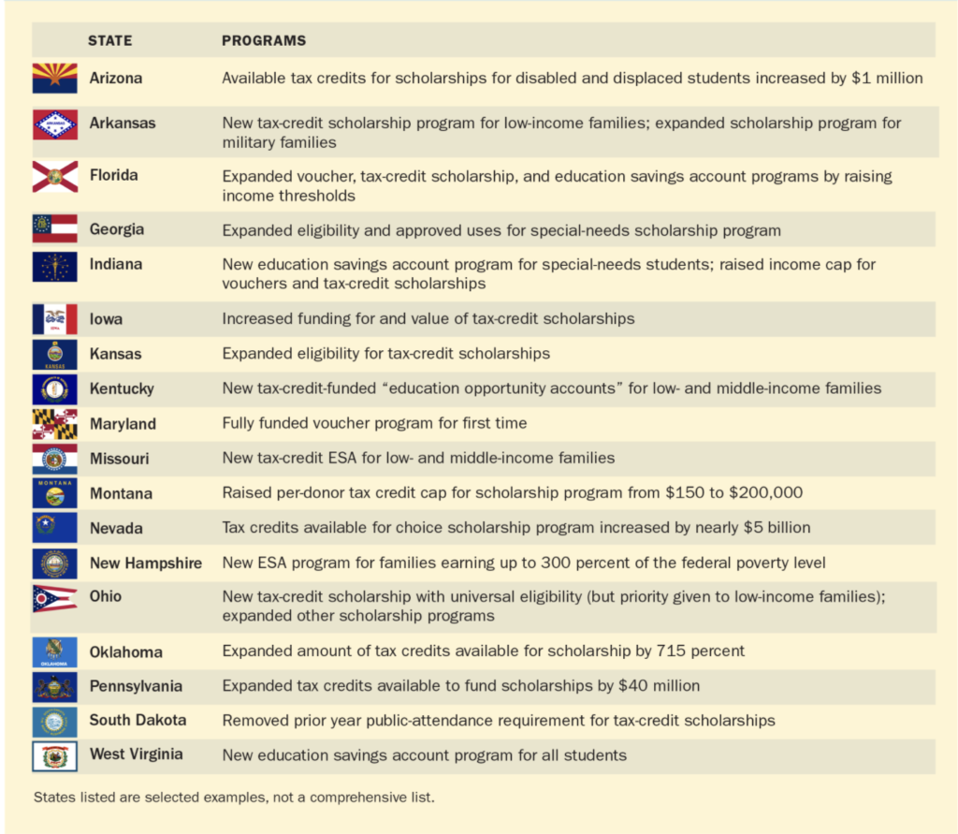
Choice exploded in wake of pandemic

Slide 22
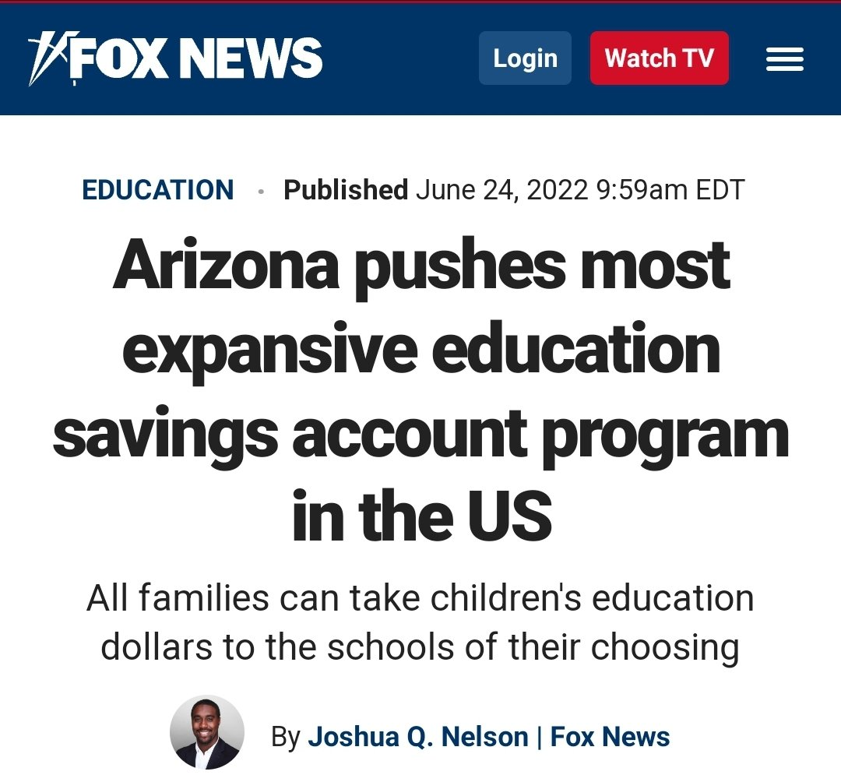

Slide 23
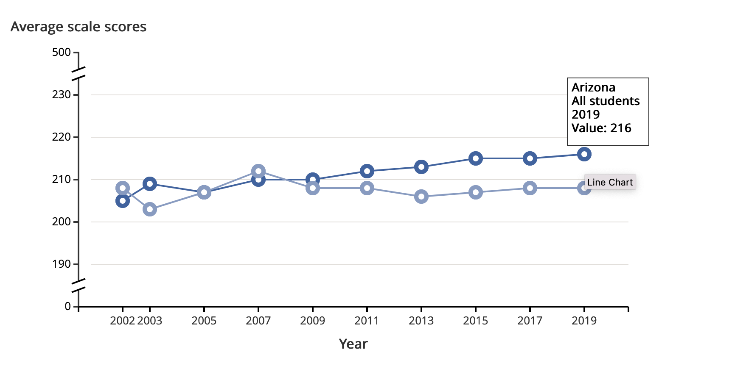
National Assessment of Education Progress: 4th Grade Reading

Slide 24
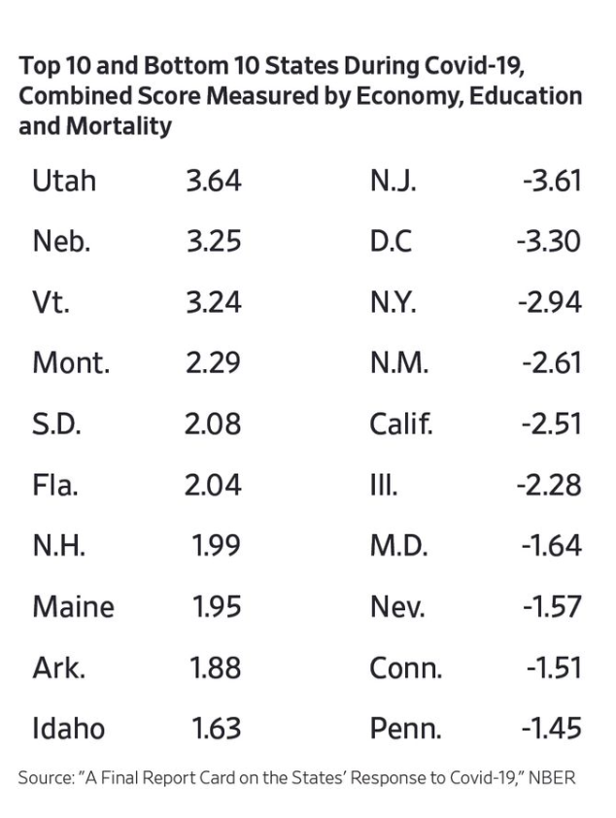
New NBER report gives NM poor marks on COVID

Slide 25
What to do?
1. The Legislature MUST overhaul the State’s emergency laws;
2. The Legislature must reform the State’s gross receipts tax and remove other disincentives/obstacles to work;
3. The Legislature must allow education dollars to follow students.

Slide 26
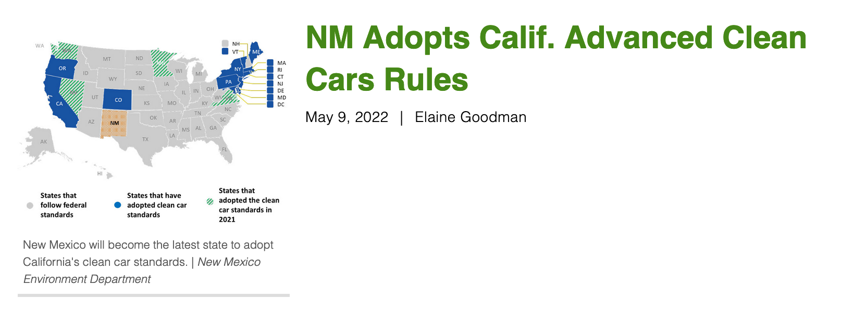

Slide 27
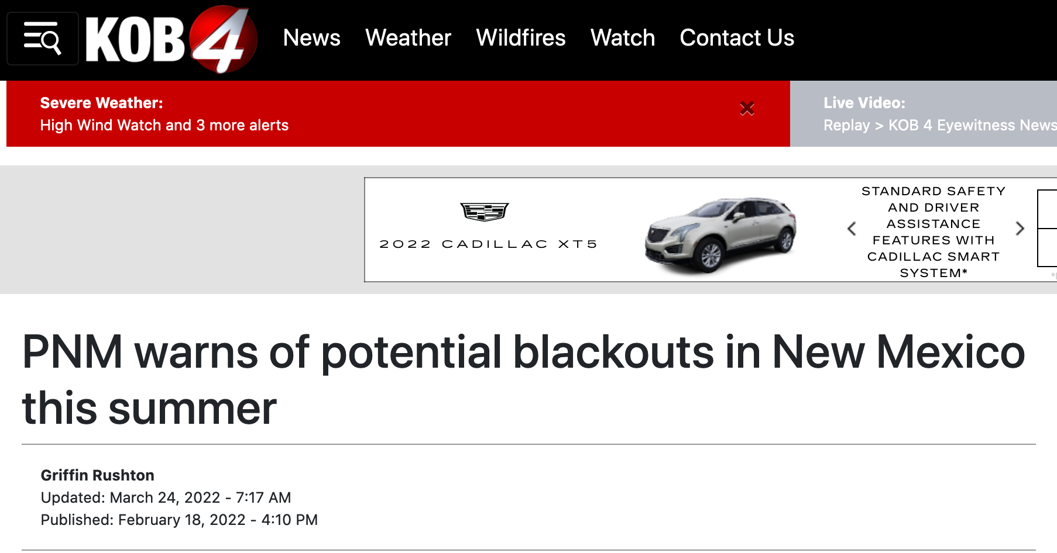

Slide 28
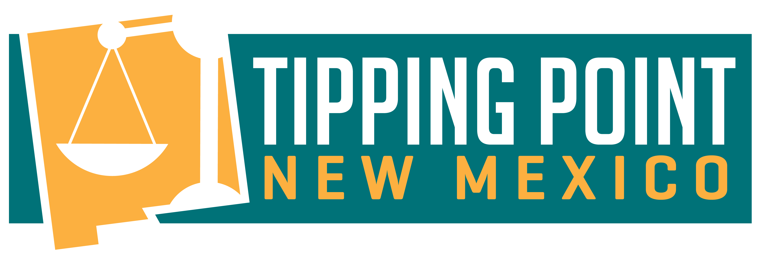
Find out More
Rio Grande Foundation
PO Box 40336
Albuquerque, NM 87196
505-264-6090
www.riograndefoundation.org
@riogranefndn

