Slide 1
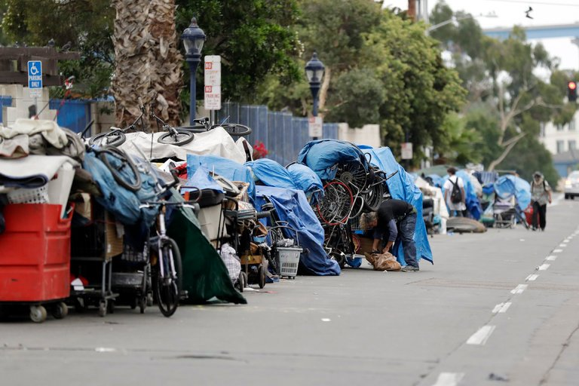
Homelessness and Housing in America
Judge Glock
June 2023

Slide 2
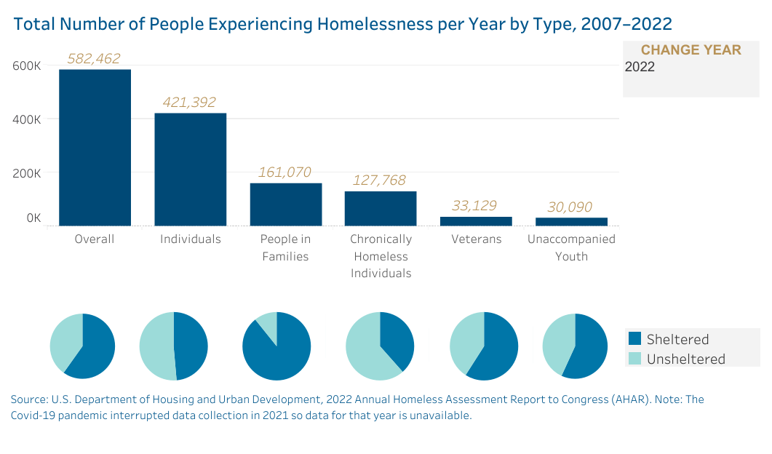

Slide 3
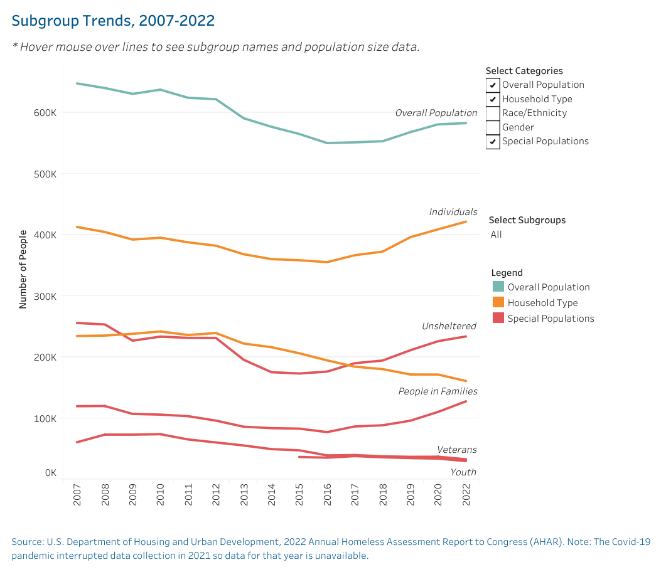

Slide 4
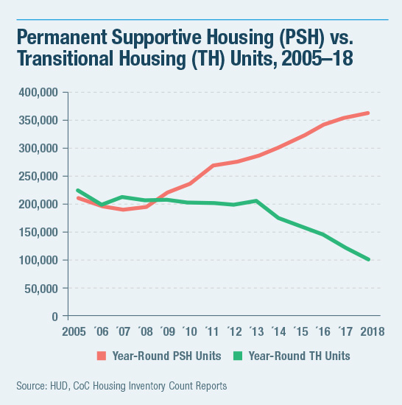

Slide 5
New Mexico
Hit a nadir of 2,263 homeless in 2016. Most recent report found 3,850, with almost 50% increase just since 2022. Rate of homelessness is slightly above the national average.
The recent jump, as in most of the Western parts of America, has been in the unsheltered, especially in large cities. In 2016 only 454 unsheltered in the state. Now about 1,600.
Many cities I’ve worked with have no shelter capacity available. That is not the case in New Mexico with a doubling of shelter capacity in recent years which means almost half of shelter beds are unused.

Slide 6
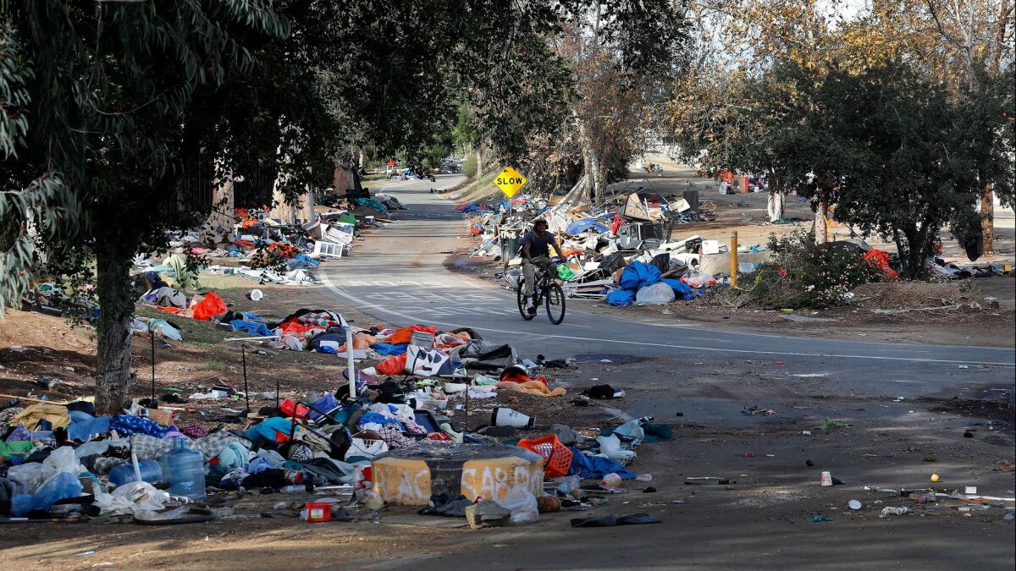
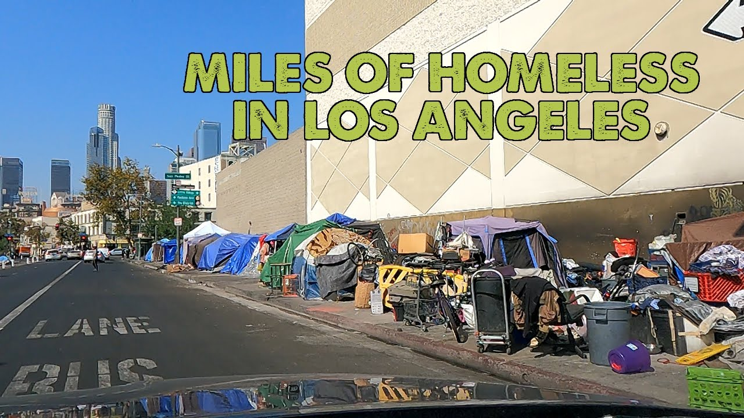
What Causes it?
There is some correlation with housing prices…but seems to mainly effect sheltered, not unsheltered or chronic
There is a very strong correlation with temperature…there are few unsheltered homeless in Wisconsin
Cities that have a “right to shelter” have a lot more homeless (Boston, DC, NYC)
California itself is off the charts, even when considering other factors. Half of all unsheltered are in California. Policy matters.
Yes, the homeless have very high rates of mental illness and drug abuse. For unsheltered around 75% in each case.
Deaths are increasing rapidly, mainly because of drug overdoses. LA from c. 500 to 2,000 homeless deaths a year.

Slide 7
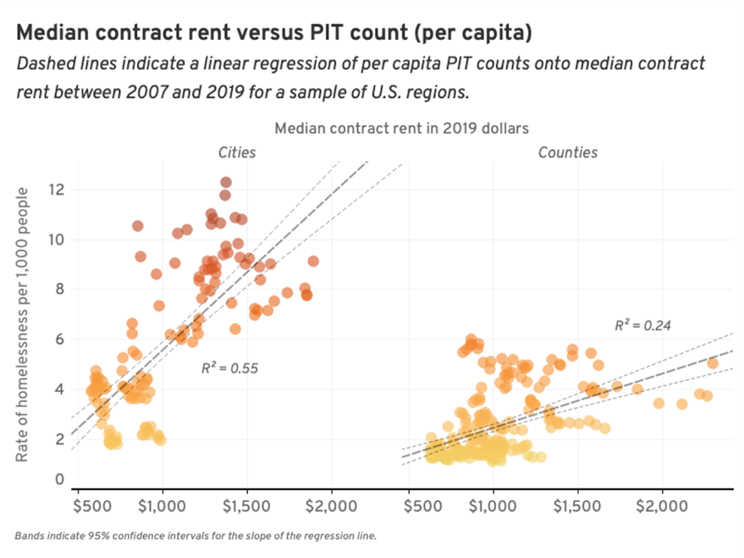
Causes of Homelessness

Slide 8
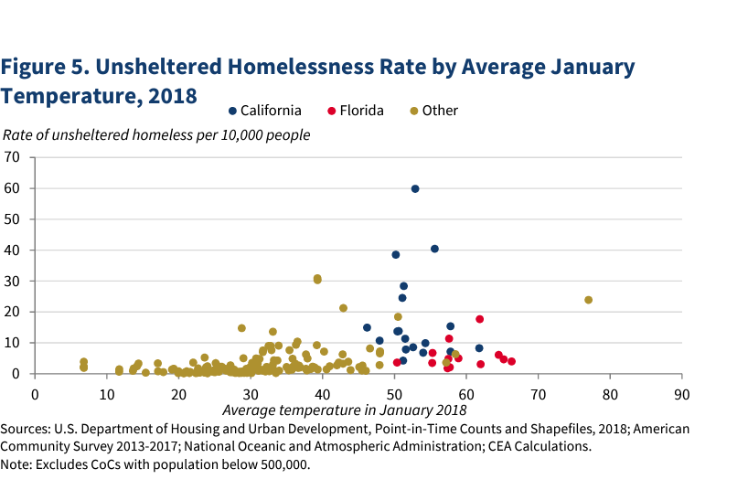

Slide 9
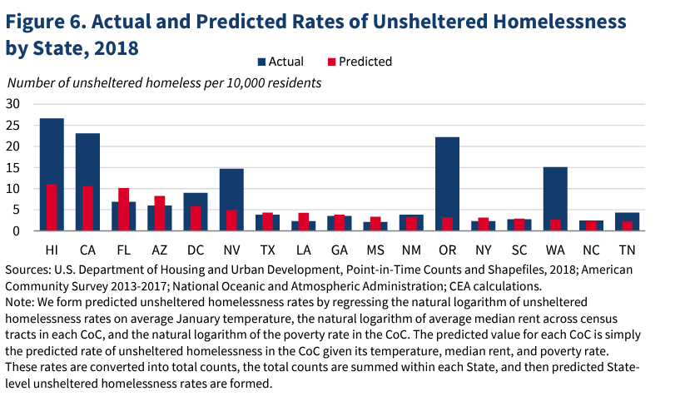

Slide 10
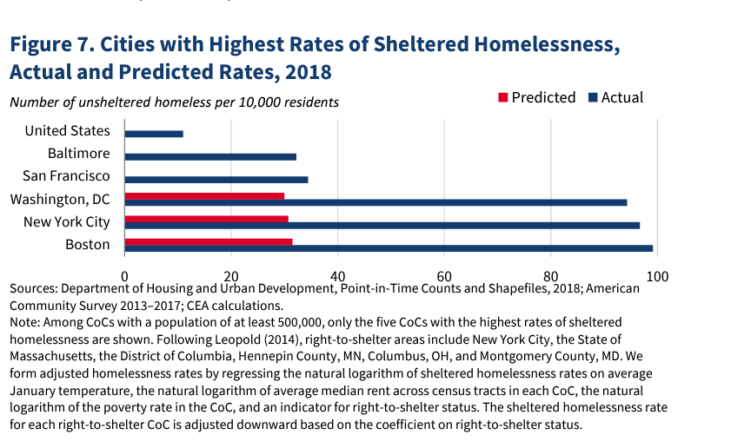

Slide 11
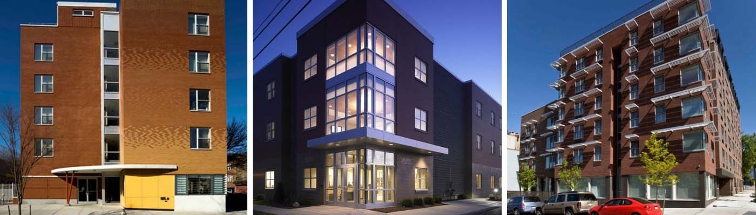
Federal Policies
“Housing First” – since 2013, goal is to house every chronically homeless person with free/heavily subsidized house with no mandated treatment
Funding given to Continuums of Care, local “cartels” as some nonprofits call them
Who gets priority for house? A point system, VI-SPDAT in most places – selling drugs: 1 point, losing kids to child services: 1 point, acts of violence: 1 point, etc.

Slide 12
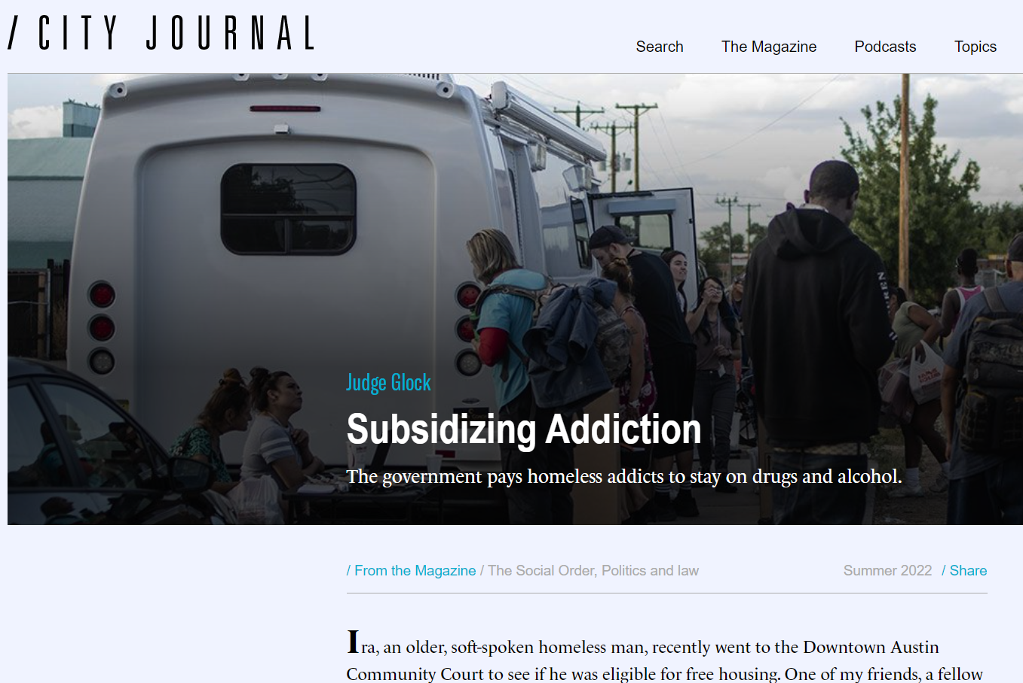
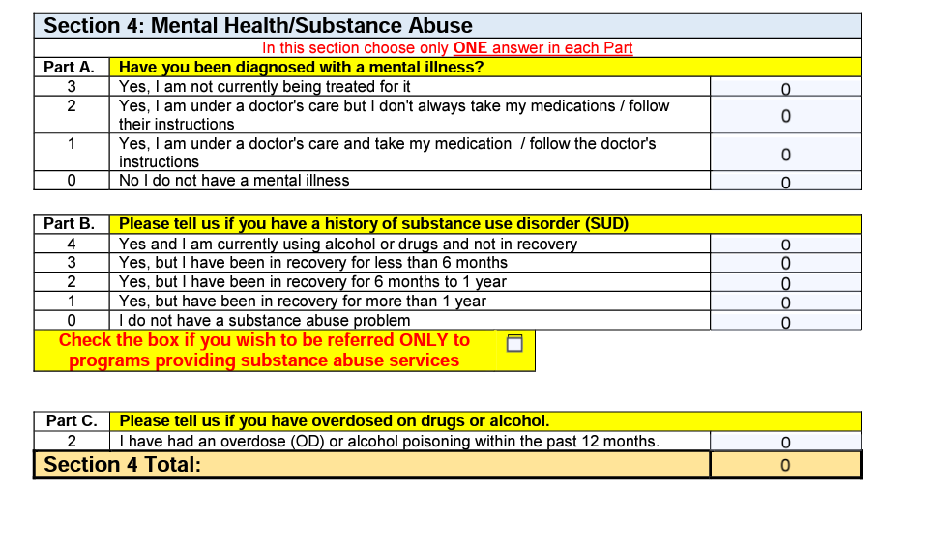
Points for Abuse

Slide 13
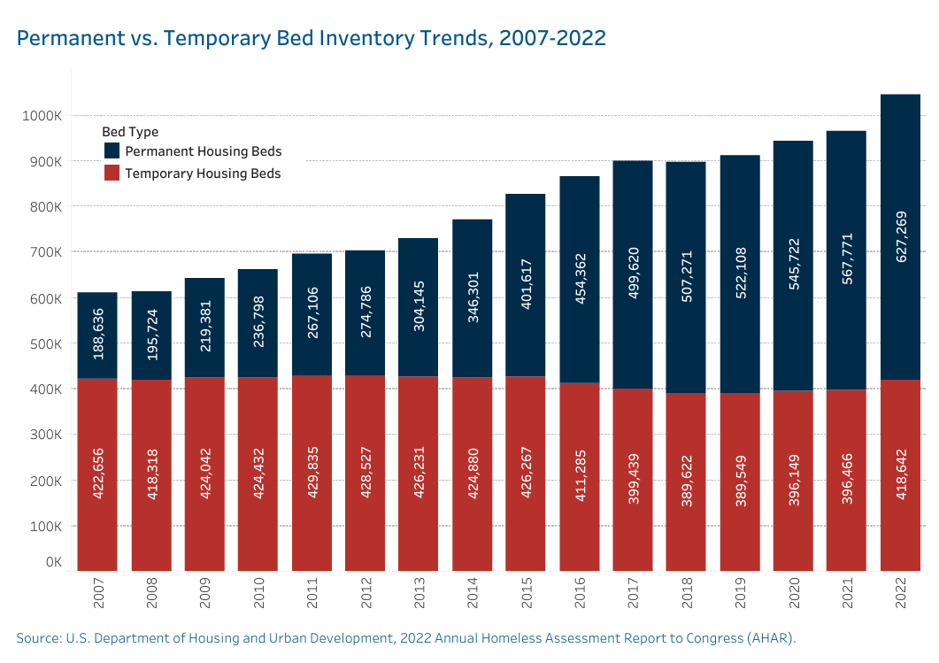

Slide 14
Housing First, Early Hopes
Sam Tsemberis of NYC created Housing First idea in 1992, mainly for severally mentally ill.
Early results showed strong benefits: 88% housed versus 47% residential treatment (Tsemberis 2000). Some Dennis Culhane research showed reduction in costs

Slide 15
Metastudies and Randomized Controlled Trials
First, National Academy of Sciences
Substantial increases in remaining housed, but length of time open to question
“In summary, the committee finds that providing PSH to individuals with high medical needs who are also experiencing homelessness decreases emergency department use and hospital stays” No effect on substance abuse.
Findings “there is no substantial published evidence as yet to demonstrate that PSH improves health outcomes.”. Also “there is insufficient evidence to demonstrate that the PSH model saves health care costs or is cost-effective.”
Lancet Study 2020
Showed significant increases in housing stability over 6 years.
“Permanent supportive housing had no measurable effect on the severity of psychiatric symptoms (ten studies), substance use (nine studies), income (two studies), or employment outcomes (one study)”

Slide 16
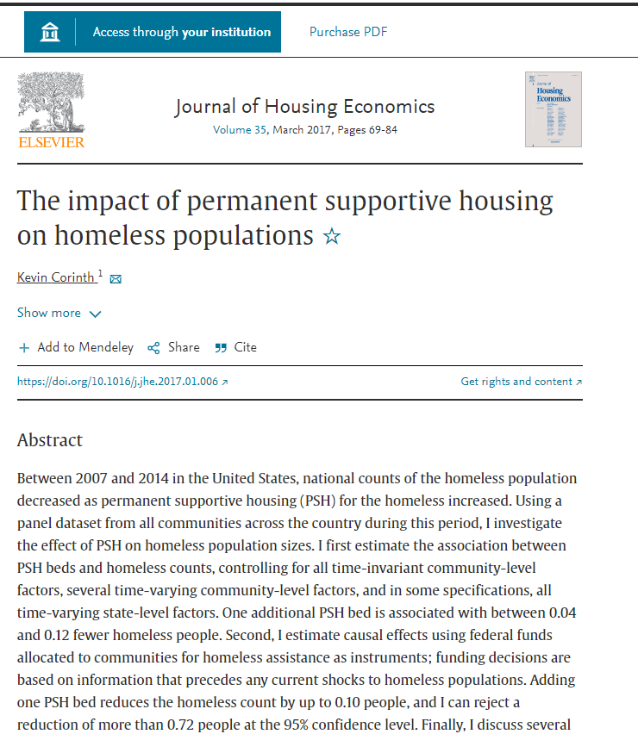
PSH reduces homelessness in city by about 1 for every 10 units built Why? About 1/3 of Austin, LA, SF, from outside the county. In San Francisco 11% of homeless were formerly in PH.

Slide 17
Denver Randomized Control Trial
Reductions in arrests, 10 to 5 over three years, (but largely in quality of life crime, drugs, liquor, warrant) not serious crime. Jail days reduced 140 to 90.
Reductions in detox, 7 to 1, some, but not significant, EMS reduction
Reductions in shelter stays, 270 in three years to 150 (but still 150!)
77% of “living participants” still housed after three years. But down to 68% if including that 12% had died (higher than 8% left on street, but not statistically significant)
Long-term retention rates not dissimilar from Boston Chronic Study only 12% housed after 10 years, almost half had died (but older population)

Slide 18
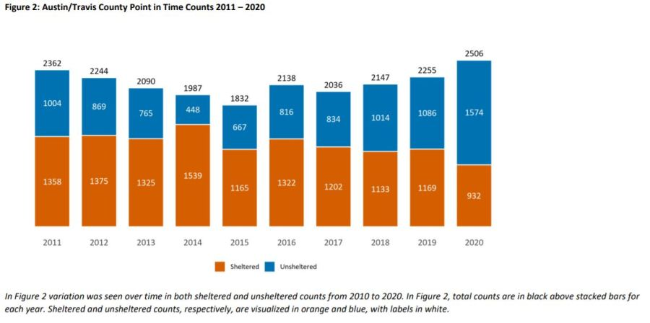
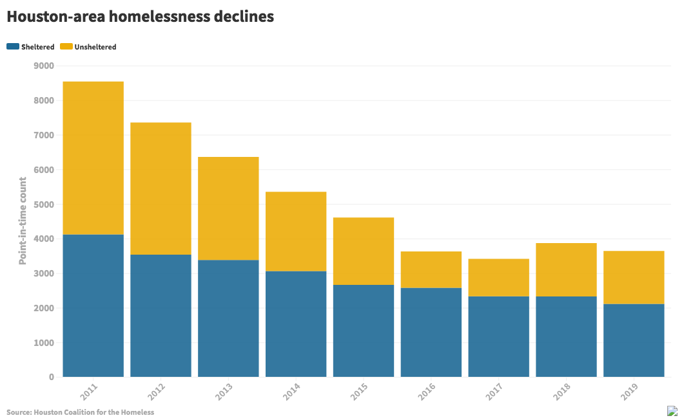
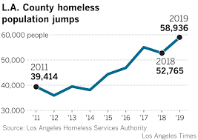
Tale of Three Cities

Slide 19
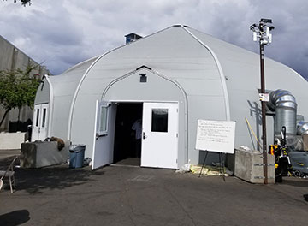
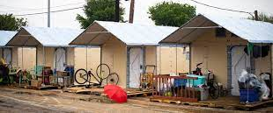
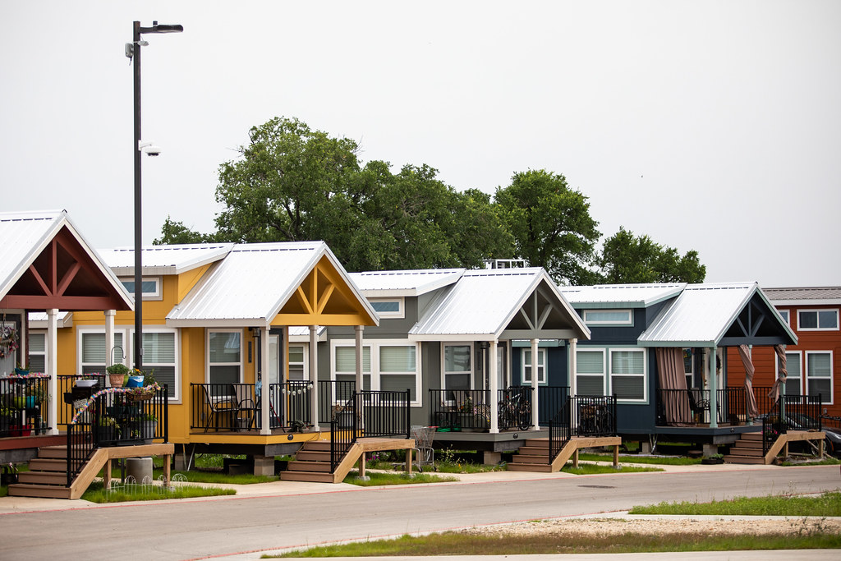
Better Places

Slide 20
Alternatives
Treatment-based housing (Oxford House others) has higher success rates, but obviously much lower take-up and very low retention. “Treatment First”
Sanctioned camping/tiny homes? 1/20th of the capital cost of housing. Advantage and disadvantage is that it is immediate and short-term
Does enforcement work? Some studies such as Berk & McDonald (2010) show that removing street encampment has significant reductions in death and violent crime (40% in that case), with no spillovers. Some successes (LA post-2006, Colorado Springs post-2010).
More market-rate housing reduces rents and allows many, even with just SSI or other gov. support, to move inside

Slide 21
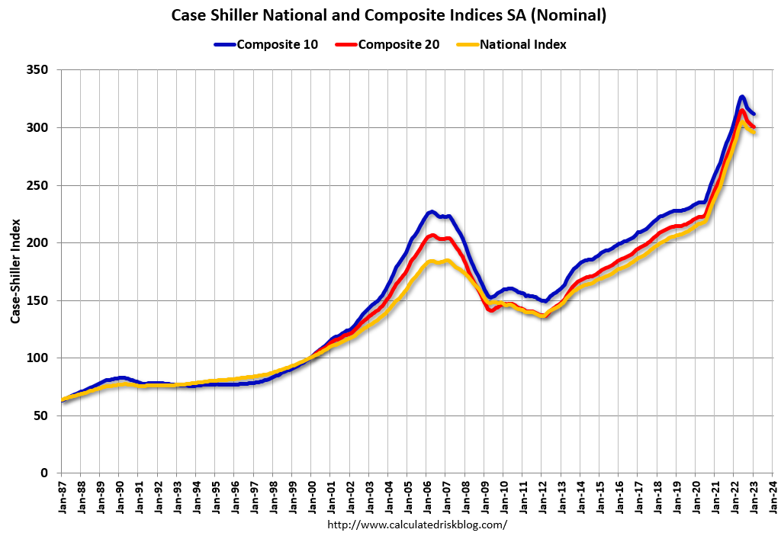
Housing Prices

Slide 22
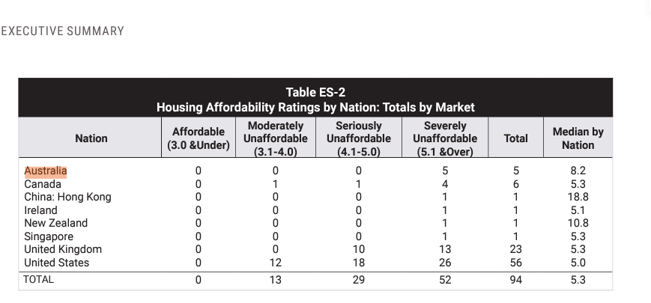

Slide 23
Reasons for US “success” and variability
Wide Variability: Oklahoma City 3.6, Atlanta, 4.5
Los Angeles, San Jose, Honolulu, all above 11
Almost everywhere has zoning, CA is densest in nation. Eg, zoning against density can be one factor in housing prices, but not only or even largest one
More common problems pervasive local and environmental opposition to building out, or building on hills. In New Mexico, however, limited space to build out. Need more up as well.

